Slide 1
Rishi
AICloud Team
Notes:
ID=d924773e-9a16-4d6d-9803-8cb819e99682 Recipe=text_billboard Type=TextOnly Variant=0 FamilyID=AccentBoxWalbaum_Zero

Slide 2

Agenda
Scenarios
Features
Introduction
Goals & Non-Goals
UX Design
Competitors
Plan

Slide 3


Introduction
For many problems related to capacity management in Azure, the decision-making process needs a primary stage of predicting the future usage or demands for the subscriptions on Azure at different levels. This project aims to provide a toolkit for domain practitioners in AIOps field to conduct predictions through a user-friendly interface without having to take care of the complex model selection and parameter tuning procedure.

Slide 4
Scenarios

Slide 5
Small and medium enterprises/institutions/schools (non-experts)
Xiao Wang has just opened a Taobao shop…
10/9/2020

Slide 6
AIOps or Related Practitioners in Resource Management Team (experts)
Xiao Li is an operation engineer of Azure…
10/9/2020

Slide 7
Features

Slide 8
From the User Scenario Perspective
Easy-to-use interface, for both experts & non-experts
User-defined loss function/optimization objective function to choose prediction model and tune parameters, such as hit rate, overestimate rate, etc.
Integrate database queries such as Kusto queries.
10/9/2020

Slide 9
From the Model Integration Perspective
Can call different off-the-shelf models and compare these models in the validation set
Select candidate of models based on the amount of data (prior knowledge on model capability)
Allow uploading model of a specific form and incorporate into the comparison for a fair comparison result
10/9/2020

Slide 10
Goal & Non Goal

Slide 11
Goals & Non-Goals
Goals
Non-Goals
We are going to provide an easy-to-use tool based on state-of-art models.
We are going to find the best model and parameters for the user.
We hope to integrate it into Azure.
We are not going to design new models or algorithms.
10/9/2020

Slide 12
UX Design

Slide 13
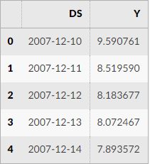
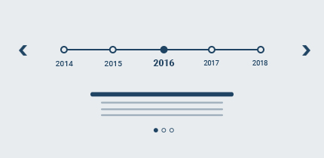
For Non-experts
Input by drag-and-click operations
Input by timeline slider (if integrated into azure)
10/9/2020

Slide 14
For Non-experts
Keep dirty work in the background
Data pre-processing with a few clicks
Auto parameters tuning
10/9/2020

Slide 15
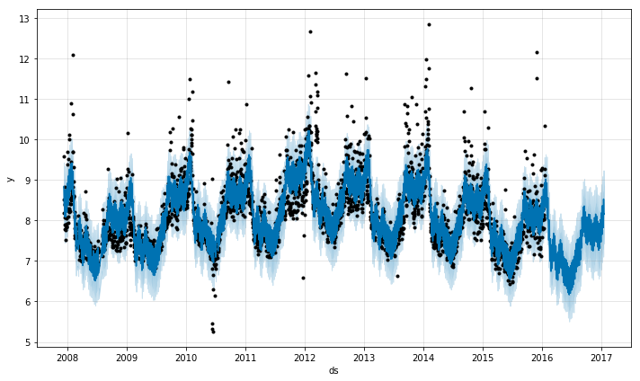
For Non-experts
Output by plotting forecast
10/9/2020

Slide 16
For AIOps Practitioners (experts)
Input form with scripts integration
User-define loss function
Uploading models of a specific form
StormEvents
| where StartTime >= datetime(2007-11-01) and StartTime < datetime(2007-12-01)
| where VM == “F03"
| Forecast
| Plot
10/9/2020

Slide 17
Competitors

Slide 18



Competitors
PROTHET
Azure ML
GluonTS
A forecast lib providing Python API and R API.
Fit with yearly, weekly, and daily seasonality, plus holiday effects.
Works best with time series that have strong seasonal effects and several seasons of historical data.
User-friendly
Select models
Mainly tree-based models.
A toolkit for probabilistic time series modeling, focusing on deep learning-based models
Customize by class extension.
Less encapsulated than PROPHET
10/9/2020

Slide 19
Plan
Time | Work
Week 2 | Feature Spec
Week 4 | Design Spec
Week 9 | Code Complete
Week 10 | ZBB ( Zero Bug Bounce )
Week 12 | Release
10/9/2020

Slide 20
Proposed solution
User Interface
Keep users from dirty work.
Model execution and parameter search module
Off-the-model sets
Output module
Plots and forms
Easy to use interface, for both experts & non experts.
Input Module
Data pre-processing module
Timeline selection
Parameter tuning
10/9/2020

Slide 21







Thank you
AICloud Team
v-wjiany@microsoft.com
https://github.com/MS-ASE-2020/team-aicloud
10/9/2020

